Slide 1
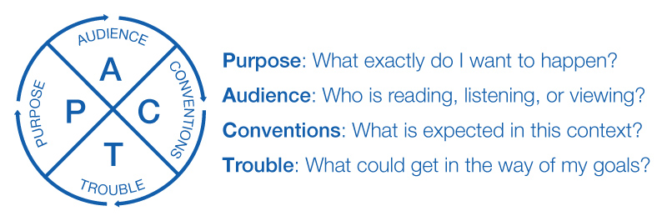
PACT for Assignment Design
SpeakWrite.wvu.edu
Notes:
Welcome! This SpeakWrite video outlines ways to use PACT—purpose, audience, conventions, and trouble spots—for assignment design.
When you use PACT for assignment design, you demonstrate to your students that the four key concepts apply to all sorts of communication situations.
You might even use PURPOSE, AUDIENCE, CONVENTIONS, and TROUBLE SPOTS as headings within your assignment to make sure that you have given your students the information that they need.

Slide 2
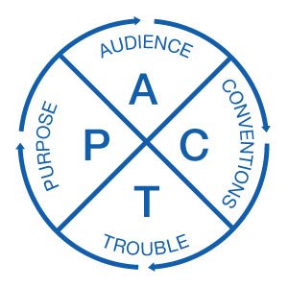
PURPOSE
What should students learn or demonstrate?
Notes:
Let's start with PURPOSE. Why are your students doing this assignment? What are your goals? [CLICK]

Slide 3
Notes:
What should your students learn or be able to demonstrate?

Slide 4
AUDIENCE
What do students need to know to do well on this project?
To whom are they writing or speaking?
Notes:
In terms of AUDIENCE, what do your students need to know in order to do well on this project? And what about the AUDIENCE for the project itself?

Slide 5
Notes:
To whom are your students writing or speaking? To peers? To you? To professionals in the field? To a mix of readers, viewers, or listeners?
Have you mentioned these points on the assignment sheet or during class?

Slide 6
CONVENTIONS
What format or genre?
How long?
How formal?
What order? (IMRaD?)
Any use of headings? Any particular citation style?
Any samples?
Notes:
Most writing and speaking situations have at least a few established CONVENTIONS. In terms of your assignment, what format or genre are you expecting? How long should it be? How formal?

Slide 7
Notes:
Is there any particular order students should use when compiling their work? For instance, is it conventional in your field to organize research by Introduction, Results, Methods, and Discussion?
Would you like students to use headings? Do you want them to use any particular citation style? Are there a few samples that students could look at for ideas?

Slide 8
TROUBLE
Where do students sometimes struggle with this project?
Can you suggest any resources such as a Library Guide, office hours, the Writing Studio, or the SpeakWrite website?
Notes:
And finally, TROUBLE SPOTS. Where do students sometimes struggle with this project?
Can you suggest any resources that may help them with your assignment? Perhaps you can point them to a Library Guide or remind them of your own office hours.

Slide 9
Notes:
Or maybe you can use PACT to frame your evaluative criteria. Could the Writing Studio or the SpeakWrite offer some help?

Slide 10
PACT
SpeakWrite.wvu.edu
Notes:
For more information on PACT--and more resources!--we hope you will visit SpeakWrite.wvu.edu

